Slide 1
DIVERSITY

Slide 2
Principle of Diversity
Can you tolerate if your call disconnects when you are discussing important matter on call while you travel?
Deep fade : strong destructive interference that results in temporary failure of communication due to severe drop in SNR.
This happens in Single link between TX and RX.
WHAT DO WE DO?
AN ALTERNATE SOLUTION IS DIVERSITY
Provide multiple link such that receiver gets redundant copy of same signal and selects the best signal with greater power.
Achieved at higher cost – needs more antenna
Ensure information reaches receiver on statistically independent channels

Slide 3
Modification in the receiver system
If one radio path undergoes a deep fade another independent path may have a strong signal.

Slide 4
Types OF DIVERSITY
Diversity
Micro Diversity
Spatial diversity
Time diversity
Macro Diversity
Frequency diversity
Angular diversity
Polarization diversity

Slide 5
MACRO-DIVERSITY
Prevents Large Scale fading.
Large Scale fading is caused by shadowing due to variation in both the terrain profile and the nature of the surroundings.
This fading is prevented by selecting an antenna which is not shadowed when others are, this allows increase in the signal‐to‐noise ratio.
Simulcast is used to implement this. In simulcast, the same signal is transmitted simultaneously from different BSs. In cellular applications the two BSs should be synchronized, and transmit the signals intended for a specific user in such a way that the two waves arrive at the RX almost simultaneously.

Slide 6
MICRO - DIVERSITY
Prevents Small Scale fading.
Small Scale fading is caused by multiple reflections from the surroundings. It is characterized by deep and rapid amplitude fluctuations which occur as the mobile moves over distances of a few wavelength.
This fading is prevented by selecting an antenna which gives a strong signal that mitigates this small signal fading effect.

Slide 7
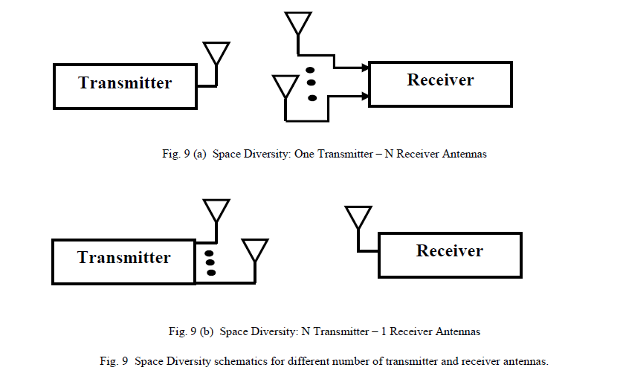
Spatial DIVERSITY
A method of transmission (transmit diversity) or reception (reception diversity), or both, in which the effects of fading are minimized by the simultaneous use of two or more physically separated antennas, ideally separated by a distance to ensure independent fading.
Ex: Site based Diversity where receiving antennas are located at different sites. (vehicle mounted and hand held radios communicate with base station)

Slide 8
TIME DIVERSITY
The signals representing the same information are sent over the same channel at different times with significant time difference between different transmissions.

Slide 9
FREQUENCY DIVERSITY
The same information signal is transmitted and received simultaneously on two or more independent fading carrier frequencies.

Slide 10
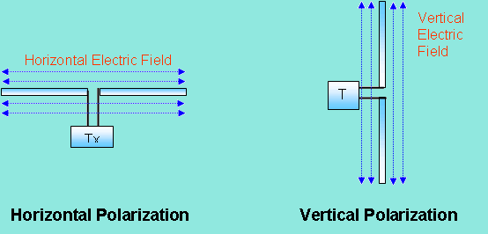
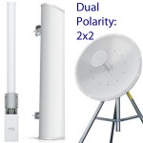
Polarization Diversity
Polarization diversity uses antennas of different polarizations i.e. horizontal and vertical.
The antennas take advantage of the multipath propagation characteristics to receive separate uncorrelated signals

Slide 11
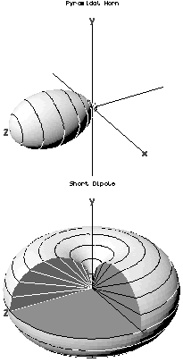
ANGLE DIVERSITY
Involves multiple antennas with different antenna patterns ( Received Signal arrives at different paths each with different angle of arrival).

Slide 12
END OF UNIT-2

